Slide 1
Casekit
YQuantum 2025

Slide 2
Our Work
We used a Quantum Alternate Controlled Walk-Based Block Hashing (QACWBH) algorithm to create a quantum hash function with the necessary cryptographic properties

Slide 3
Cryptographic properties
Output Determinism
Identical output for identical input
Entropy Preservation
High entropy due to quantum interference
Computational Difficulty/Preimage Resistance
Reverse engineering is infeasible on classical hardware
Avalanche effect
Minor change in input results in significant change in output
Collision resistance
Two different inputs lead to two different outputs

Slide 4
Our Method

Slide 5
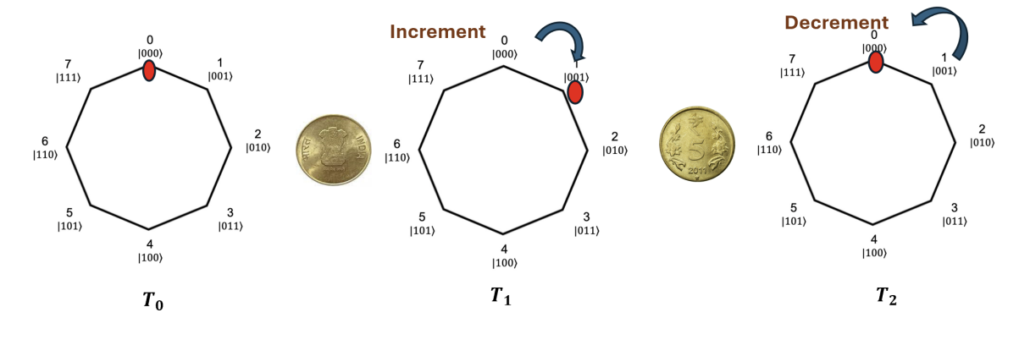
Discrete-Time Quantum Walk
A way to incorporate unpredictability into the quantum hashing, which allows for the avalanche effect and higher entropy

Slide 6
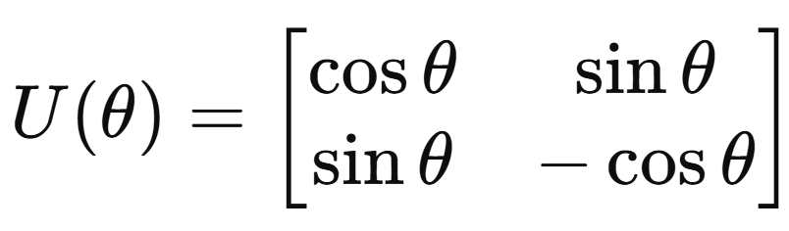
Discrete-Time Quantum Walk
Quantum Circuit Overview
Q position qubits: Q = log₂N
1 coin qubit
Controlled Coin Operator

Slide 7
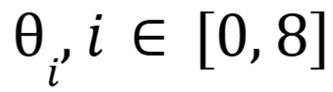
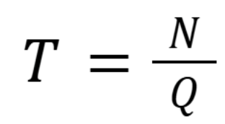
Discrete-Time Quantum Walk
Implementation
Apply coin flips on a byte level, where the value of the byte dictates the theta.
The circuit evolves for T steps. Each set applies a coin flip, followed by CNOT gates to entangle the coin and position registers.
After this, the hash extraction is performed by scaling Qiskit’s Statevector.

Slide 8
Our Results

Slide 9
Feasibility and Performance
Qubit Efficiency
Input of 256 bits requires no more than 6 qubits
Execution Time
32-byte inputs result in a sub-second hashing time
Quantum-Only Design
All computation, entropy diffusion, and hash generation are realized within the quantum circuit
Notes:
Inputs up to 256 bits require no more than six qubits, satisfying hardware limitations for near-term quantum processors.
Simulation tests demonstrate sub-second hashing times for 32-byte inputs on classical hardware, with time scaling linearly with input size.
CAQWBH performs no classical digesting or compression. All computation, entropy diffusion, and hash generation are realized within the quantum circuit, ensuring a purely quantum hash function.

Slide 10
QACWBH Analysis
Bit-level entropy: 0.99998 (out of 1.0)
Byte-level entropy: 7.93799 (out of 8.0)
Total Collisions: 0 (out of 1,000+ shots)
Time Elapsed (s): 6.38646 (For 100 shots)
Avalanche: Approximately 50%
These results suggest that the hash function preserves input entropy well, produces uniformly distributed outputs, and demonstrates no empirical collisions across the tested input space.

Slide 11
QHASH Analysis
Bit-level entropy: 0.98752 (out of 1.0)
Byte-level entropy: 6.38749 (out of 8.0)
Total Collisions: 18 (100 shots)
Time Elapsed: 40.25469 (100 shots)
Avalanche: 15.3%
These results reflects the analysis of the QHASH example code. We compared our results with this data to determine that our results outperformed this code in every test.

Slide 12
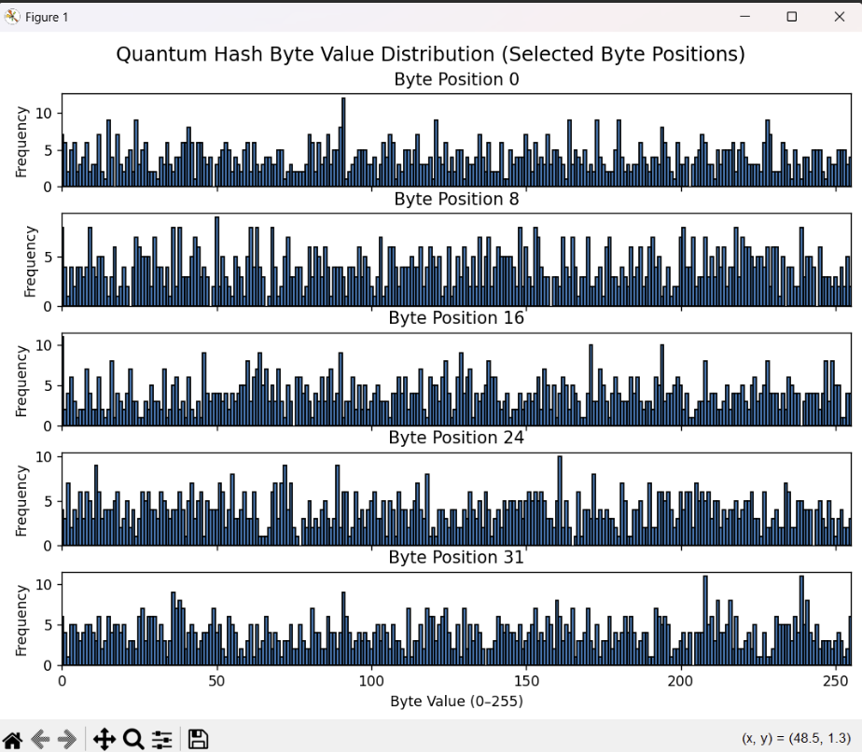
Fig. 1. Byte value distribution across 1000 quantum hash outputs at selected byte positions. The uniformity suggests high entropy and no dominant byte patterns.

Slide 13
References
[1] D. Li, P. Ding, Y. Zhou, and Y. Yang, “Controlled Alternate Quantum Walk based Block Hash Function,” arXiv preprint arXiv:2205.05983, 2022. [Online]. Available: https://arxiv.org/abs/2205.05983

